Slide 1
Cloud in Your IT Sky ?
Security and Legal Topics
Mike Leithead
Law Department
IBM Canada

Slide 2
Disclaimer
Agenda:
Cloud Basics and Key Issues
Financial Sector Fact Case
The opinions expressed herein are those of the author and do not necessarily represent those of IBM Canada Limited, any of the IBM group of Companies
The material presented is general and informational and based on observations in the marketplace. The fact case pattern is not based on a particular event but on varied observed opportunities.

Slide 3
What is Cloud?
Cloud Computing is:
  “a model for enabling convenient, on-demand network access to a shared pool of configurable computing resources (e.g., networks, servers, storage, applications, and services) that can be rapidly provisioned and released with minimal management effort or service provider interaction.”
- National Institute of Standards and Technology (US)
Being an emerging model, there are:
- many commercial implementations of Cloud Computing
- not fully established, but evolving standards

Slide 4





Traditional IT environments can no longer fully support the needs of the mission – 85% of new apps will run in cloud.
~70%
of IT budgets spent maintaining systems
85%
of new applications will be deployed via the cloud
Systems of Record
Secure Data
Dynamic Infrastructure
On-demand Self-service
Systems of Engagement
Knowledge Sharing
Engagement Models
Anywhere, Anytime
Optimization
Innovation
Source: IDC; Converged Systems: End-User Survey Results presentation; September 2012; Doc #236966
Source: IDC, Five Steps to Successful Integrated Cloud Management, May 2011

Slide 5






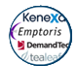
IBM’s holistic strategic approach with composable parts
IBM Cloud Services Portfolio
Enabling business transformation
Smarter Commerce
Business Process
as a Service
Business Process
Solutions
Smarter Analytics
Application
Application
Application
Application
Application
Smarter Cities
Marketplace of high-value, consumable business applications
Smarter Workforce
Watson solutions
Software
as a Service
External
Ecosystem
Industry
Collaboration
Human
Resources
Big Data & Analytics
Commerce
Marketing
Software solutions
Bluemix
Composable and integrated application development platform
Modular Automated Management
Built using open standards
Platform
as a Service
Development
Big Data & Analytics
Security
Integration
Mobile
Social
Traditional
Workloads
Managed Infrastructure Private Cloud
Middleware solutions
SoftLayer
Enterprise class, optimized infrastructure
IBM Cloud Managed Services
Built using open standards
Infrastructure
as a Service
IBM Cloud for System z
Compute
Storage
Networking
Infrastructure solutions
IBM Cloud Builder
Public. Private. Dynamic Hybrid.
Automated Modular Management

Slide 6
The reality of digital transformation
Everything you will need won’t be in one place in the digital world.
Data and services from multiple sources and environments
Mobile and other models of engagement driven through clouds
Innovation fueled by communities of developers and experts
Hybrid Cloud
Off-Premises
On-Premises
10

Slide 7
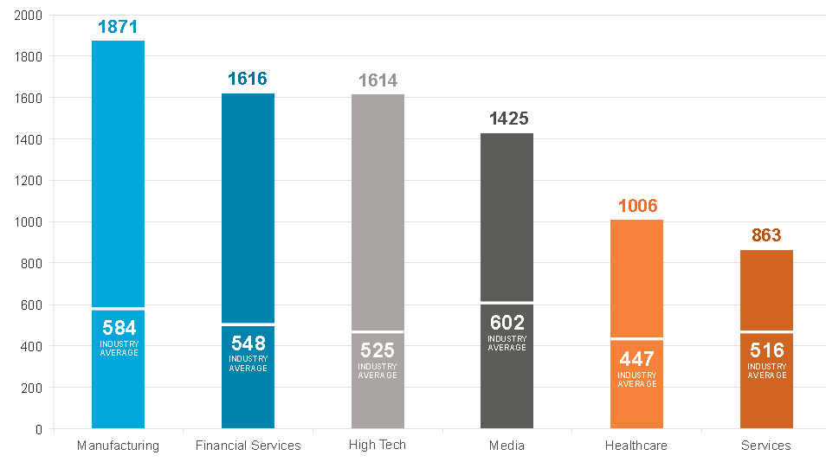
Market adoption of IaaS, PaaS, and SaaS is more pervasive than many think. While a CIO will typically admit to using 10-15 public cloud services, the average enterprise is using over 850.
Average Enterprise uses 846 public cloud services
Skyhigh Networks – Q1 2014 report
Notes:
7
7

Slide 8



LOB innovate at the speed the customer expects by tapping into cloud services. Their primary adoption path is as a consumer of off-premise SaaS.
Enterprise Application Cloud Adoption Steps
 | From | To
 | Traditional IT | Dedicated On-Premise Cloud | Dedicated Off-Premise Cloud | Shared Off- Premise Cloud
Business Process as a Service (BPaaS)
Software as a Service (SaaS)
Platform as a Service (PaaS)
Infrastructure as a Service (IaaS)
Traditional IT
One Enterprises customer aware of 5-10 Cloud Services while Skyhigh identified 800+ cloud services.
Consumer – Bus Leader
Consumer – Bus Leader
Consumer – Bus Leader

Slide 9
Cloud is a computing style that creates value by increasing economic potential, promoting agility, security, efficiency and cost control
Cloud computing is a pay-per-use consumption and delivery model that enables real-time delivery of configurable computing resources
Cloud empowers 6 key benefits
Speed, agility, and scalability
Cloud’s essential characteristics
Security rich and highly available
Broad Network Access
Rapid Elasticity
Improved Efficiency
Cost optimized
On-demand self service
Measured service
Masked complexity
Resource Pooling
Ecosystem connectivity
Source: NIST, IBM IBV Power of cloud study

Slide 10
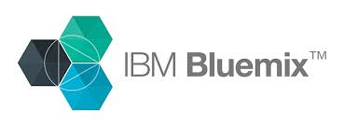











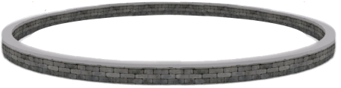










Hybrid Cloud Applications are becoming the norm for the Integrated Digital Enterprise …
…
Public Cloud
Dedicated Cloud
Private Cloud
DMZ
Enterprise
DMZ
APP
Service
APP
Social & Internet Data sources
Mobile, PoS, ATMs
APP
DB
Service
APP
DB
APP
DB
Internet
Internet
API
API
Internet of Things
Sensors
Developer & Customer communities
Trading partner communities
Master Data Management
Big Data
Notes:
10

Slide 11




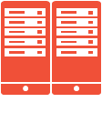







Hybrid cloud: integrating across clouds and with traditional IT
Your Business Logic and Data
3rd Party Services & Data
Private
Dedicated
Public
…
Traditional IT
…

Slide 12






Realities and challenges: an example from Financial Services
Dedicated off-premise cloud
Public cloud
SECURE
IBM API Management
Security
PaaS
Traditional MW
IaaS
PaaS
ICO, PureApp Service
- Urban Code
SECURE
In the journey to a digital transformation that fuels innovation and agility, key enterprise
concerns are integration, governance and management
On-premise
Digital Banking
Existing Bank Platform
Security
Integration
Core Transaction Systems

Slide 13


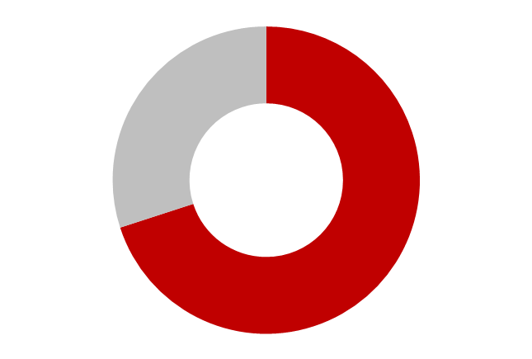
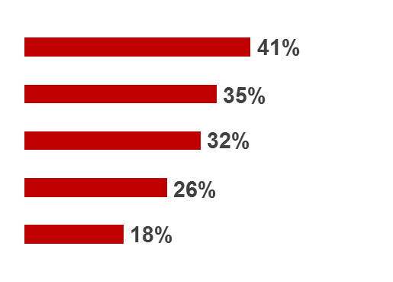

Security is a key cloud inhibitor:
SECURITY
#1 inhibitor
with Cloud Computing
Top 5
security concerns
with Cloud Computing
85%
Data Security
Access and Control
Auditing and Compliance
Control of Data
Security Models / Toolsets

Slide 14





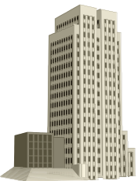

Why an inhibitor? Because the cloud introduces complexity that many security organizations are unprepared to face…
Today’s Data Center
Tomorrow’s Hybrid Cloud
?
?
?
?
?
?
Who Has Control?
Where is it located?
Where is it stored?
Who backs it up?
Who has access?
How resilient is it?
How do auditors observe?
How does our security
team engage?
We Have Control
It’s located at X.
It’s stored in server’s Y, Z.
We have backups in place.
Our admins control access.
Our uptime is sufficient.
The auditors are happy.
Our security team is engaged.

Slide 15






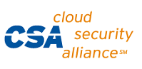
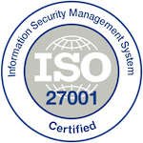

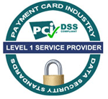


SoftLayer supports deployment of regulated workloads through extensive compliance and clear delineation of roles and responsibilities.
SoftLayer cannot access customer data
  Only customers control movement of their data
SoftLayer offers comprehensive security services, across the IT infrastructure
Dedicated and private clouds are well suited for regulated workloads
Strict physical and operational security controls are in place in data centers
SoftLayer is compliant with major industry and regulatory standards
PCI SAQ
US Government standard SP800-53
Targeted for 2015
PCI ROC
PCI AOC

Slide 16


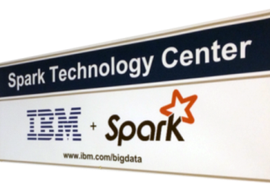

DC Economics
IT Control &
Economics
Cloud Scale &
Economics
Traditional IT
Private
Dedicated
Public
Across public and private sources - and geographies.
Regulatory compliance needs data localization and management
  seamlessly move data to compute and compute to data
Enabled by global data centers, cognitive services, enterprise integration, and portability

Slide 17
Regulated Fact Case and OSFI* Considerations
A Canadian financial services corporation wants to expand its online service offerings in the area of wealth management including benefit management for employers.
Part of the offering is directed at public sector entities, essentially outsourcing part of their HR Benefit operations.
The offering will require IT support on existing legacy services but also cloud enabled services to allow for flexible scaling and avoid capital investment.
The cloud solution will include:
  Server and storage infrastructure
  Software as a service including for certain front end processes like client on boarding
  Linkages to legacy systems
  *Office of the Superintendent of Financial Institutions (Canada)

Slide 18
OSFI guideline B-10: Outsourcing of Business Activities, Functions and Processes
Financial institutions outsource business activities, functions and processes to meet the challenges of technological innovation, increased specialization, cost control, and heightened competition. However, outsourcing can increase an institution’s dependence on third parties, which may increase its risk profile. Many financial sector regulators have responded by introducing guidance related to the management of outsourcing risks.
This Guideline sets out OSFI’s expectations for federally regulated entities (FREs) that outsource, or contemplate outsourcing, one or more of their business activities to a service provider.
These expectations should be considered prudent practices, procedures or standards that should be applied according to the characteristics of the outsourcing arrangement and the circumstances of the FRE.
FREs have the flexibility to configure their operations in the way most suited to achieving their corporate objectives. However, this Guideline operates on the premise that FREs retain ultimate accountability for all outsourced activities. Furthermore, OSFI‘s supervisory powers should not be constrained, irrespective of whether an activity is conducted in-house, outsourced, or otherwise obtained from a third party.
Under this Guideline, FREs are expected to:
evaluate the risks associated with all existing and proposed outsourcing arrangements;
develop a process for determining the materiality of arrangements;
implement a program for managing and monitoring risks, commensurate with the materiality of the arrangements;
ensure that the board of directors, chief agent or principal officer receives information sufficient to enable them to discharge their duties under this Guideline; and
refrain from outsourcing certain business activities to the external auditor (see Section 4.3).
OSFI’s specific expectations may vary, depending on the nature of the outsourcing arrangement being contemplated and the relationship between the FRE and the service provider. As outlined in its Supervisory Framework, OSFI applies a risk-based approach to assessing an FRE’s safety and soundness on a consolidated basis.

Slide 19
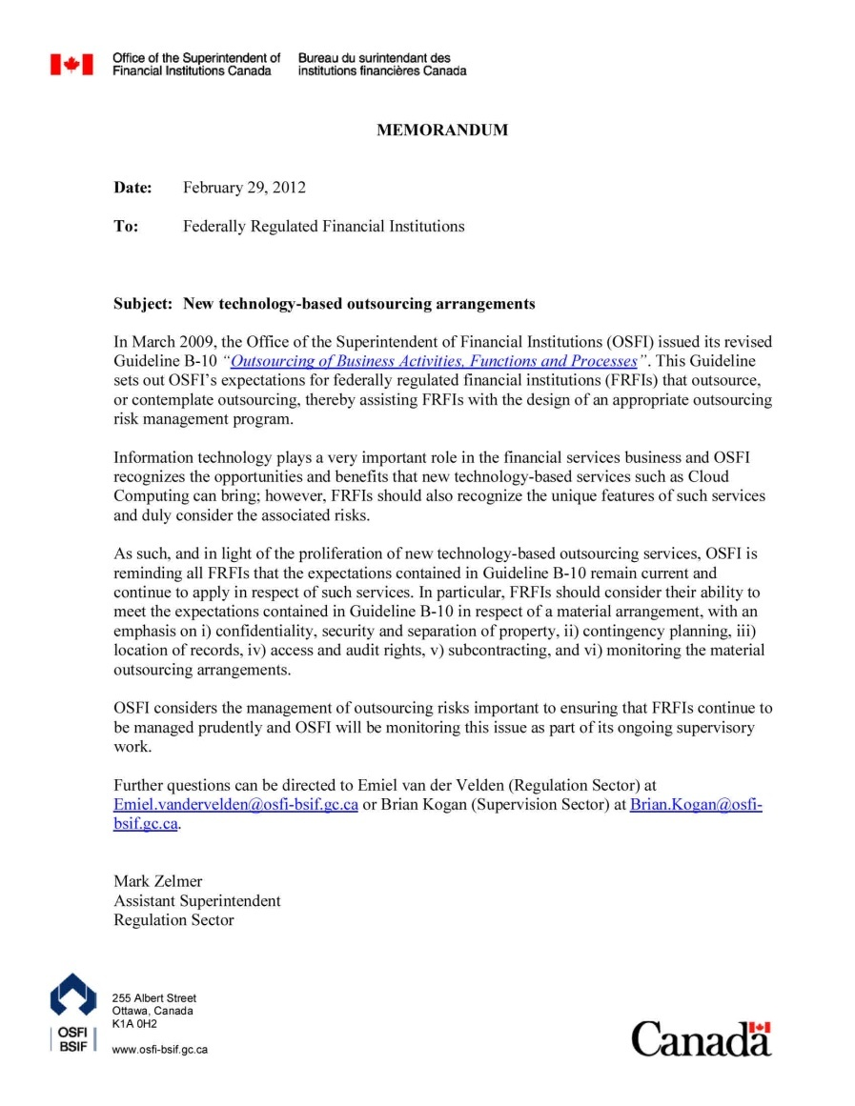
OSFI emphasized 6 areas where FRFIs should consider their ability to meet the expectations of B-10 when using Cloud services
Confidentiality, security, and separation of property
Contingency planning
Location of records
Access and audit rights
Subcontracting
Monitoring the material outsourcing agreement

Slide 20
How does the cloud service address the client standards that are implemented to address OSFI Guideline B-10 expectations
Guideline |  | Focus Points
Confidentiality, security, and separation of property | At a minimum, the contract or outsourcing agreement is expected to set out the FRE’s requirements for confidentiality and security. Ideally, the security and confidentiality policies adopted by the service provider would be commensurate with those of the FRE and should meet a reasonable standard in the circumstances. The contract or outsourcing agreement should address which party has responsibility for protection mechanisms, the scope of the information to be protected, the powers of each party to change security procedures and requirements, which party may be liable for any losses that might result from a security breach, and notification requirements if there is a breach of security. OSFI expects appropriate security and data confidentiality protections to be in place. The service provider is expected to be able to logically isolate the FRE’s data, records, and items in process from those of other clients at all times, including under adverse conditions. | Allocation of responsibilities between cloud provider, customer and other vendors External controls audits like SSAE 16 Security Standards How is the physical and logical separation of data handled (Public Cloud, Private or Hybrid): Reporting Data ownership and security Data deleted upon cancellation

Slide 21

Cloud Computing: Impact on Security & Privacy
End
Users
Functional interfaces
Cloud
Service
In-house
Applications
&
Systems
App
code
DevOps
Admin interfaces
Security Components
App environment
Administrators
Business interfaces
Business
Managers
In-house data
Derived data
Customer data
Cloud service customer
Cloud service provider
Split of Security Responsibilities

Slide 22
ISO Cloud Computing standards
  17788: Cloud computing Overview and Vocabulary*
  17789: Cloud computing Reference Architecture*
  19086: Cloud computing SLAs
  19941: Cloud computing Interoperability & Portability
  19944: Cloud computing Data Flow across devices & cloud services
  27001: Information security management systems ― Requirements
  27002: Code of practice for information security controls
  27017: Guidelines on Information security controls for the use of cloud computing services based on ISO/IEC 27002*
  27018: Code of practice for data protection controls for public cloud computing services
  27036: Information security for supplier relationships
  29101: Privacy architecture framework
Black = Complete, published
Red = In preparation, draft
* = Joint standard with ITUT

Slide 23
How does the cloud service address the client standards that are implemented to address OSFI Guideline B-10 expectations
Guideline |  | Focus Points
Contingency planning | The contract or outsourcing agreement should outline the service provider’s measures for ensuring the continuation of the outsourced business activity in the event of problems and events that may affect the service provider’s operation, including systems breakdown and natural disaster, and other reasonably foreseeable events. The FRE should ensure that the service provider regularly tests its business recovery system as it pertains to the outsourced activity, notifies the FRE of the test results, and addresses any material deficiencies. The FRE is expected to provide a summary of the test results to OSFI upon reasonable notice. In addition, the FRE should be notified in the event that the service provider makes significant changes to its business resumption and contingency plans, or encounters other circumstances that might have a serious impact on the service. | Due diligence on the cloud infrastructure. Diversity of centres, network, power supply Need to focus on customer’s own business continuity planning
Location of records | In accordance with the federal financial institutions legislation, certain records of entities carrying on business in Canada should be maintained in Canada. In addition, the FRE is expected to ensure that OSFI can access in Canada any records necessary to enable OSFI to fulfill its mandate. | Data/server location options. Hybrid model with restricted data retained in-house.

Slide 24
How does the cloud service address the client standards that are implemented to address OSFI Guideline B-10 expectations
Guideline |  | Focus Points
Access and audit rights | Identification and ownership of all assets (intellectual and physical) related to the outsourcing arrangement should be clearly established, including assets generated or purchased pursuant to the outsourcing arrangement. The contract or outsourcing agreement should state whether and how the service provider has the right to use the FRE’s assets (e.g., data, hardware and software, system documentation or intellectual property) and the FRE’s right of access to those assets. The contract or outsourcing agreement is expected to clearly stipulate the audit requirements and rights of both the service provider and the FRE. At a minimum, it should give the FRE the right to evaluate the service provided or, alternatively to cause an independent auditor to evaluate, on its behalf, the service provided. This includes a review of the service provider’s internal control environment as it relates to the service being provided. In addition, in all situations, irrespective of whether an activity is conducted in-house, outsourced, or otherwise obtained from a third party, OSFI retains its supervisory powers. Accordingly, an undertaking from the service provider or a provision in the outsourcing contract, should give OSFI or the Superintendent's representative the right to: exercise the contractual rights of the FRE relating to audit; accompany the FRE (or its independent auditor) when it exercises its contractual audit rights; access and make copies of any internal audit reports (and associated working papers and recommendations) prepared by or for the service provider in respect of the service being performed for the FRE, subject to OSFI agreeing to sign appropriate confidentiality documentation in form and content satisfactory to the service provider; and access findings in the external audit of the service provider (and associated working papers and recommendations) that address the service being performed for the FRE, subject to the consent of the service provider’s external auditor and OSFI agreeing to sign appropriate confidentiality documentation in form and content satisfactory to the service provider and the external auditor. OSFI would provide the FRE with reasonable notice of its intent to exercise its audit rights and would share its findings with the FRE where appropriate. In the normal course, OSFI would seek to obtain information it requires through the FRE itself. | System Data available from cloud provider Onsite or specific audits may not be practical – what reports are available Site Visits Regulator requirements

Slide 25
How does the cloud service address the client standards that are implemented to address OSFI Guideline B-10 expectations
Guideline |  | Focus Points
Subcontracting | The contract or outsourcing agreement is expected to set out any rules or limitations to subcontracting by the service provider. In particular, security and confidentiality standards should apply to subcontracting or outsourcing arrangements by the primary service provider. Consistent with the principles of this Guideline, the audit and inspection rights of the FRE and OSFI should continue to apply to all significant subcontracting arrangements. | What if any subcontracting is done? Is it clear the provider is not relieved of any obligations due to subcontracting.
Monitoring the material outsourcing agreement | The FRE should monitor all material outsourcing arrangements to ensure that the service is being delivered in the manner expected and in accordance with the terms of the contract or outsourcing agreement. Monitoring may take the form of regular, formal meetings with the service provider and/or periodic reviews of the outsourcing arrangement’s performance measures. Within a reasonable time, the FRE should advise its OSFI relationship manager about any events that are likely to have a significant negative impact on the delivery of the service. An FRE should review its material outsourcing arrangements to ensure compliance with its outsourcing risk policies and procedures and with the expectations of this Guideline. Reviews of material outsourcing arrangements should be periodically undertaken by the FRE’s internal audit department or another independent review function either internal or external to the FRE, provided it has the appropriate knowledge and skills. The FRE’s board of directors, or the chief agent or principal officer when the FRE is a branch, will always retain overall accountability for the outsourcing arrangement. Reviews should test the FRE’s risk-management activities for outsourcing in order to: ensure risk-management policies and procedures for outsourcing are being followed; ensure effective management controls over outsourcing activities; verify the adequacy and accuracy of management information reports; and ensure that personnel involved in risk-management for outsourcing are aware of the FRE’s risk-management policies and have the expertise required to make effective decisions consistent with those policies. Management should adjust the scope of the review depending on the nature of the outsourcing arrangement. | Does the cloud provider grant client controlled and transparent access to multi level reporting and audit trails What additional layers of management are possible and practical

Slide 26
Other issues to consider
Cloud Provider Termination and Suspense rights
  Triggers
  Soft landing
Privacy
  Data controller vs. Data Processor
  Provincial restriction on storage and access outside of Canada of personal information collected by public sector (B.C. – Legislation, Alberta - Practice)
“Know your Client” and other Screening
  Who is accountable for screening and what screening should be done?
Software Licensing
  Operating as a service bureau for other employees for benefit program, do the SaaS licenses allow for that?
Changes to services, maintenance windows, Service Levels
  What does provider offer?
  Are there options to enhance?
  What is practical given nature of standardized cloud service?
Liability and Risk Issues
  Proportional risk approach

Slide 27
Any Questions?

